Slide 1
Spotify by Region
Joshua Ng – DA Flex (Jan. 20, 2025 Cohort)

Slide 2

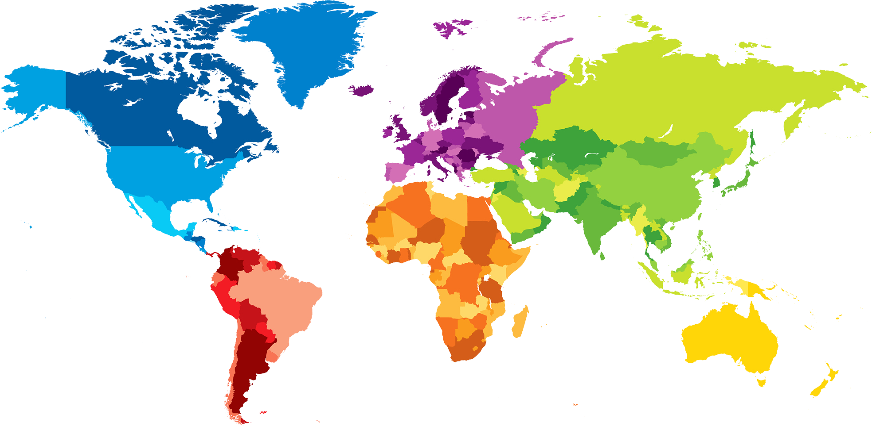
The Question
What insights can be gleaned from ?
As an international platform, how much does the data vary by region, worldwide?
Notes:
Market and business insights
Inform shows and events by venue/region with highest potential return
Which artists to partner with for collabs depending on audience/market/region product should reach?

Slide 3


The Process
Data pool sampled from Spotify’s Daily Top 200 (July 2017)
Tableau – For concise graphical representation of data
Notes:
Data cleaned and standardized for consistent analysis
Used Python for efficient and accurate cleaning: trailing spaces in text, data type as required (date, int, string, region), nulls and invalid entries missing data
Tableau leveraged for insightful visualizations

Slide 4
The Results
Tableau Dashboards - https://public.tableau.com/app/profile/josh.ng4033/vizzes
Various conclusions can be drawn and interpreted from these data visualizations
Notes:
Only limited by the time and extent to which one can take to peruse them
Can be improved by more robust and polished visualizations
Dataset as large as this requires much more powerful hardware to process efficiently

